Slide 1

Deepak jyoti
Frontend Developer

Slide 2
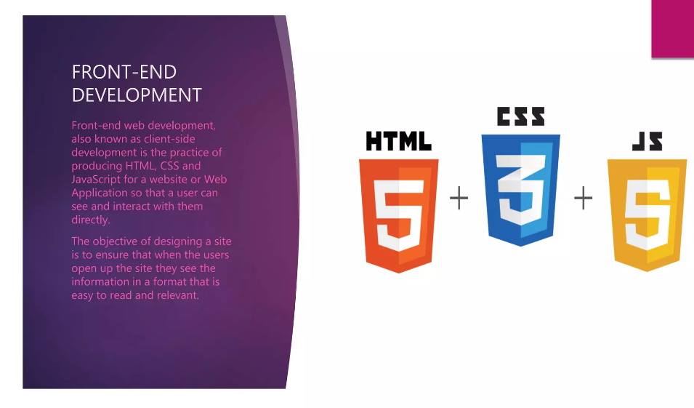
Frontend-Developer

Slide 3

Web Developer
A programmer who is specialised in the development of application releted to the world wide web.

Slide 4
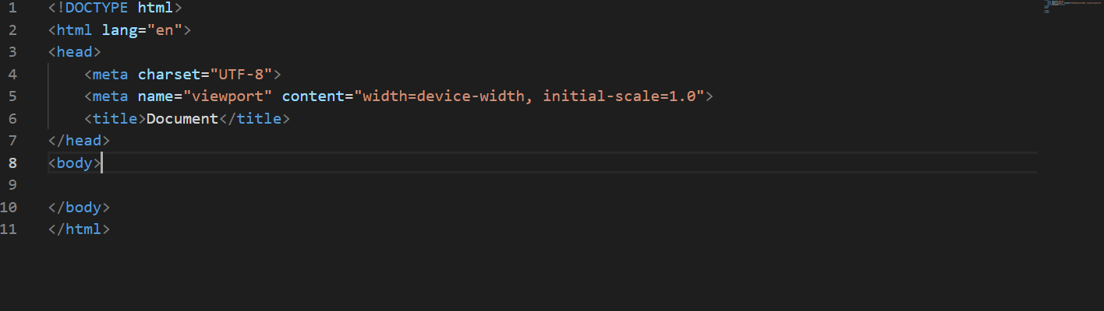
HTML (Hypertext Markup Language)
HTML is the standard markup language for creating web pages and web applications.

Slide 5
HTML
web browser receives HTML documents from a web server or from local storage.

Slide 6
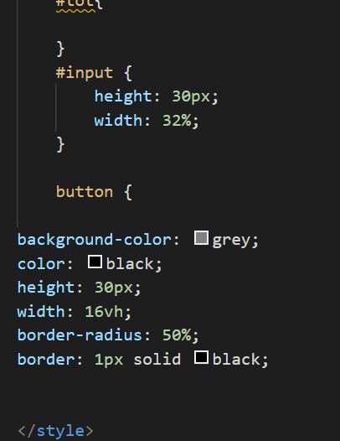
CSS (Cascading Style Sheets)
css is a styling sheet document used for the describing the presentation of the document.

Slide 7
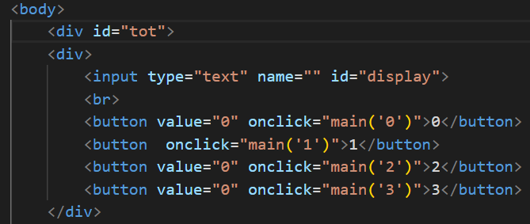
JavaScript
It is a high level interpreted programming language.
It’s a dynamic programming language.
it uses interactive
web pages.

Slide 8
THANK YOU

